Slide 1
Welcome to my Presentation on QC Frame work
Prepared by: Anika Nower
ID: 012112025
MSCSE

Slide 2
1. About QC Framework:
Objective
Overview
Scope
Reporting Add-on for User

Slide 3
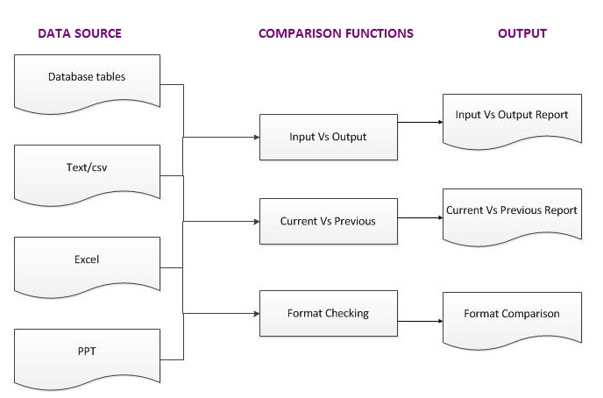
2. QC Process:

Slide 4
3. Software methodology
Agile
Agile software development is a group of software development methods based on iterative and incremental development.
Scrum
Scrum is an agile development methodology
The software development lifecycle is managed by a scrum master, who holds daily scrum meetings.

Slide 5
4.Tecnologies Utilized:
Data Source CSV:
Platform: .NET
Framework: 4.0
Language: C#
IDE: Visual Studio 2010
Application: Desktop
Data Source PPT:
Platform: .NET
Framework: 4.0
Language: C#, VBA (Excel Macro)
IDE: Visual Studio 2010
Application: Desktop
Minimum Software requirement:
Windows XP or above, .NET framework 4.0 or above

Slide 6
5.Software Functionality:
5.1 PPT CHECKER: SQL TOOL FOR PPT
The “PPT Checker” can generate configuration files (collection of shape’s property of a report) for PowerPoint reports
Check formatting consistency between two reports
Assumptions
Folder Structure
New Config
Old Config
log Files
QC Results

Slide 7
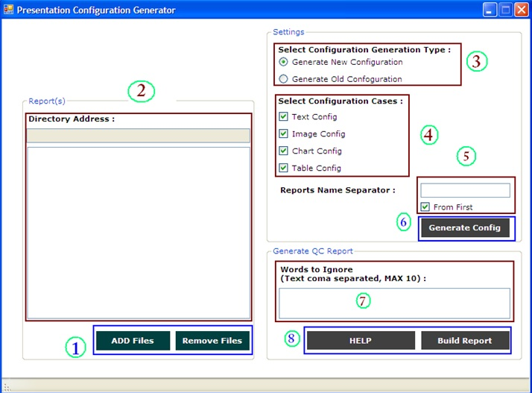
PPT User Interface:

Slide 8
PPT User Interface Contd.
Add File/Remove File
List Box
Select Configuration Generation Type
Select Configuration Cases
Report Name Selector
Generate Config
Text Box
QC Result

Slide 9
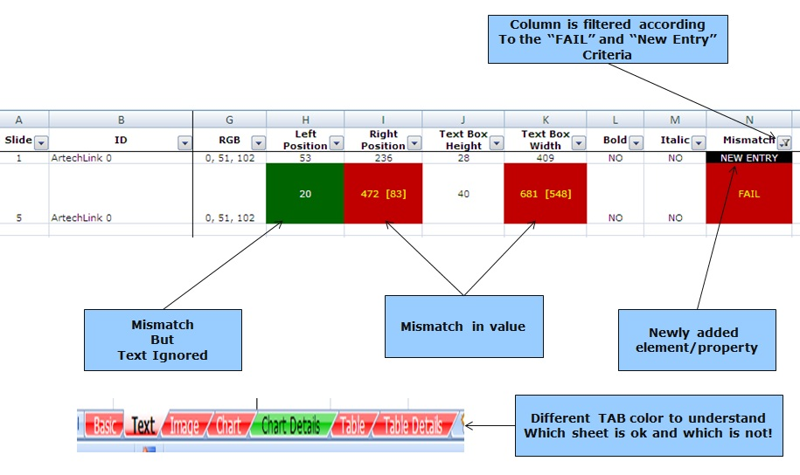
Understanding the QC report:

Slide 10
Software Functionality Contd.
5.2 CSV File
The “CSV import export” can
- Load CSV files
- Check formatting consistency between two reports
Two Simple Steps…
Step 1: Load CSV files
Step 2: Build the QC report

Slide 11
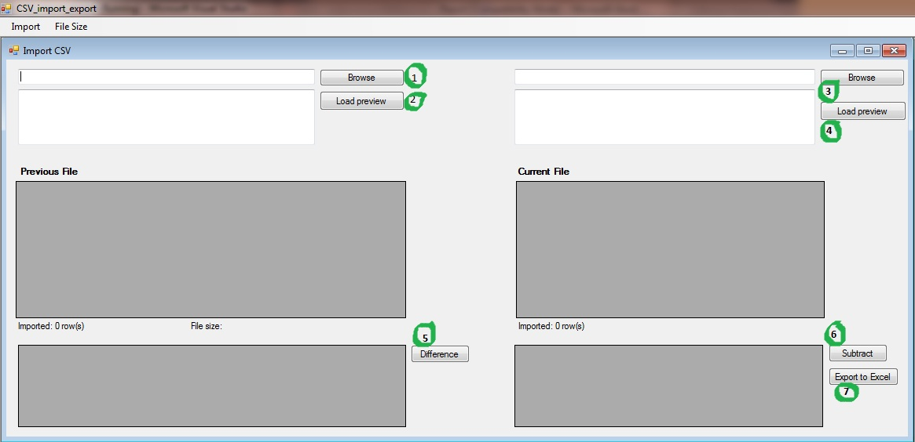
CSv User Interface:

Slide 12
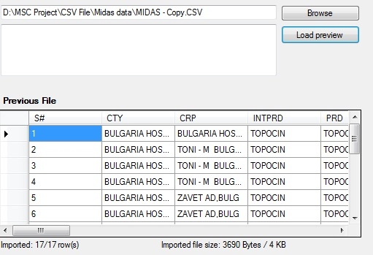
CSv User Interface Contd.
Browse the previous file.
Click Load preview to show the file is fully loaded or not.

Slide 13
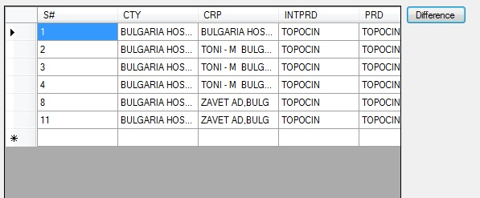
CSv User Interface Contd.
Same Process to load the file
Same Process to load the file
Click Difference to show the different row between two CSV files

Slide 14
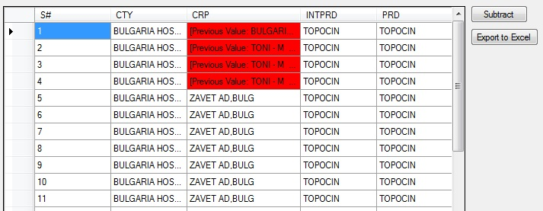
CSv User Interface Contd.
6. Click Subtract to show the different in cells between two CSV files.
7. If you want to export the CSV QC Report in excel then click export to excel. And browser the location you want. And save the file.

Slide 15
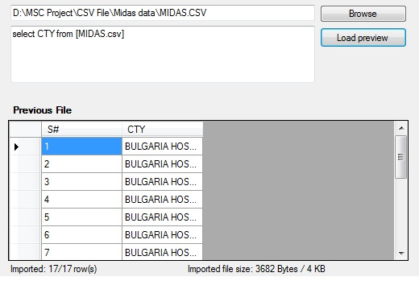
CSv User Interface Contd.
*** You can also query in CSV file. For example:

Slide 16
Conclusion:
A QC framework is established so that every project can perform same type of QC with same template. As we have different type of files so format of QC will vary accordingly and can be easily used by this framework. It is convenient to use same framework and visualise the discrepancy of data or format.

Slide 17
If you have any Question ???

Slide 18

Thank you for being with me

